Slide 1
Sociology Course Code (SS 2005)
Muhammad Zeeshan

Slide 2
SOCIAL RESEARCH- AN INTRODUCTION
Systematized effort to gain new knowledge is called research (Redman and Mory).
A systematic method of exploring, analyzing, conceptualizing social life in order to extend, correct or verify knowledge that may aid in the construction of a theory or in practice of an art (Pauline V. Young) .
Structural observation of social behavior is called social research (Wallace and Wallace).

Slide 3
TYPES OF RESEARCH
Social Research can be classified into 3 types as per:-
(i) Application of research study.
a) Pure Research (First hand research used for developing knowledge for any issue).
b) Applied Research (Application of existing research knowledge on any issue).
(ii) Objectives in undertaking research.
a) Exploratory Research (Research conducted for exploring any new indicator).
b) Descriptive Research (Research conducted to gather data, describe any issue).
c) Explanatory Research (Research conducted to understand “why” something occurred).
d) Correlational Research (To discover relationship b/w 2 or more aspects of a situation).
(iii) Inquiry mode employed.
a) Qualitative Research (Focus on opinions, subjectivity and feelings of participants of study).
b) Quantitative Research (Uses facts and figures, objectivity and structured way to an inquiry).

Slide 4
RESEARCH PROCESS
Defining the Problem, Issue. (Choose a suitable topic for study).
Review the Literature. (Going through exsisting knowledge on the topic).
Formulate the Hypothesis. (Statment the shows relationship b/w variables).
Choose a Research Design. (Plan for collection or analysis of data).
Collect the data. (All the relevant information on the topic).
Analyze the results. (Analysis and Evaluation of the information, clarifying relationship b/w variables to accept, reject or modify the hypothesis).
Draw the Conclusion. (Concluding the study, Giving recommendations and communicating the results to relevant stakeholders).

Slide 5
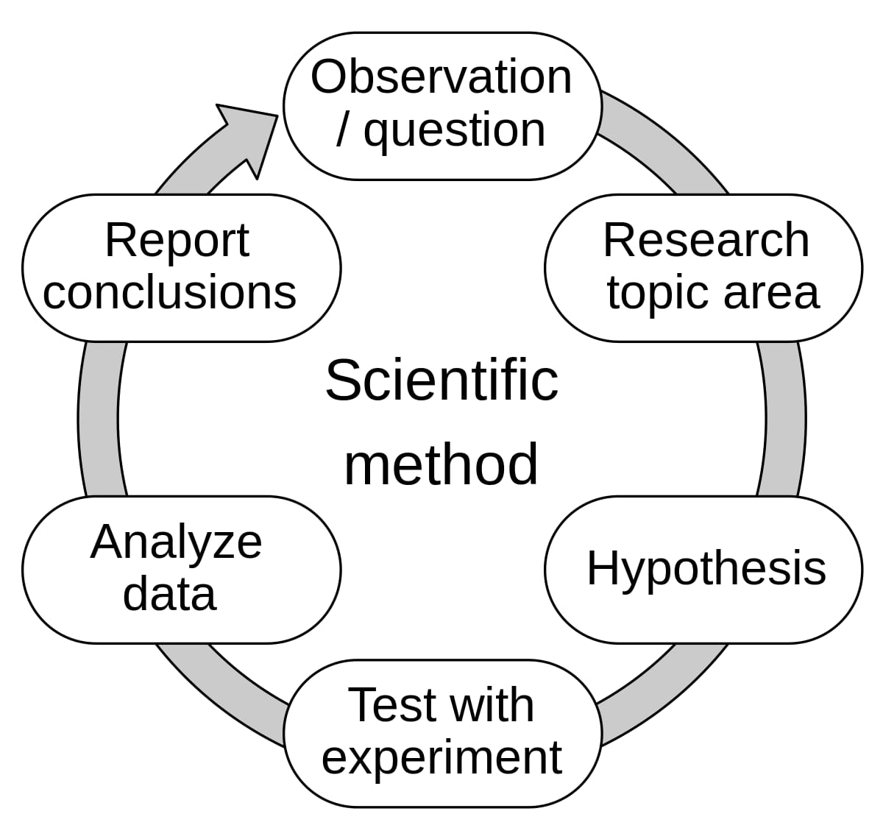
Scientific method used in Social Research

Slide 6
Research Tools
Following are some of the important research tools:-
Experiments.
Surveys.
Questionnaires.
Interviews.
Case studies.
Participant and Non-participant observation.
Observational trials.

Slide 7
Research Tools-Continue
Some of the important research tools are :-
1. INTERVIEW
An interview is a face-to-face conversation between two individuals with the sole purpose of collecting relevant information to satisfy a research purpose. Interviews are of different types namely; Structured, Semi-structured, and unstructured with each having a slight variation from the other.
2. QUESTIONNAIRES
This is the process of collecting data through an instrument consisting of a series of questions and prompts to receive a response from the individuals it is administered to. Questionnaires are designed to collect data from a group.

Slide 8
Research Tools-Continue
3. SURVEYS
A survey is a data collection tool for gathering information from a sample population, with the intention of generalizing the results to a larger population. Surveys have a variety of purposes and can be carried out in many ways depending on the objectives to be achieved.
4. REPORTING
By definition, data reporting is the process of gathering and submitting data to be further subjected to analysis. The key aspect of data reporting is reporting accurate data because inaccurate data reporting leads to uninformed decision-making.

Slide 9
Research Tools-Continue
5. OBSERVATION
This is a data collection method by which information on a phenomenon is gathered through observation. The nature of the observation could be accomplished either as a complete observer, an observer as a participant, a participant as an observer, or as a complete participant. This method is a key base for formulating a hypothesis.
6. FOCUS GROUPS DISCUSSIONS
The opposite of quantitative research which involves numerical-based data, this data collection method focuses more on qualitative research. It falls under the primary category of data based on the feelings and opinions of the respondents. This research involves asking open-ended questions to a group of individuals usually ranging from 6-10 people, to provide feedback.

Slide 10
Important Concepts in Social Research (1/3)
Concept, a mental construct that represents some part of the world in a simplified form.
Variable is a concept whose value changes from case to case.
Measurement, a procedure for determining the value of a variable in a specific case.
Operationalize a variable by specifying exactly what is to be measured before assigning a value to a variable.
Reliability refers to consistency in measurement. A measurement is reliable if repeated measurements give the same result time after time.
Validity, which means actually measuring exactly what you intend to measure.

Slide 11
Important concepts in Social Research (2/3)
Cause and effect, a relationship in which change in one variable causes change in another.
The variable that causes the change is called the independent variable.
The variable that changes is called the dependent variable.
Correlation is a relationship in which two (or more) variables change together.
Spurious correlation, an apparent but false relationship between two (or more) variables that is caused by some other variable.
Control, holding constant all variables except one in order to see clearly the effect of that variable
Objectivity, personal neutrality in conducting research.
Replication, repetition of research by other investigators.
Hypothesis, a statement of a possible relationship between two (or more) variables.

Slide 12
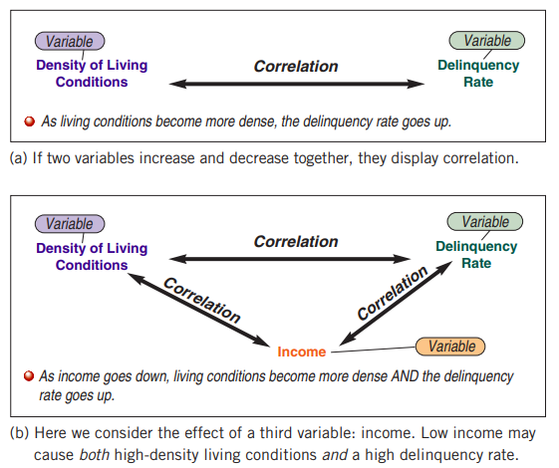
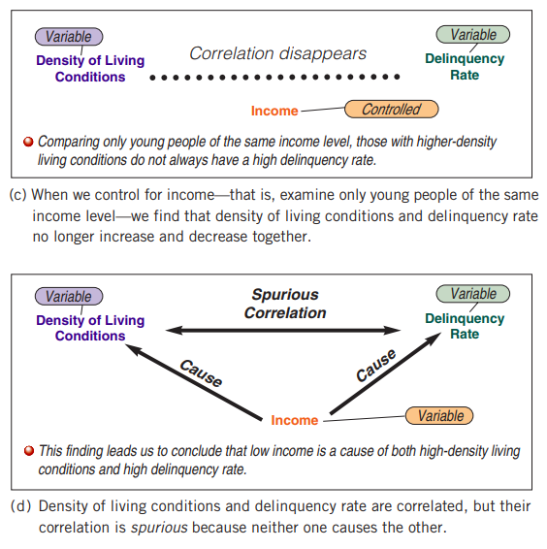

Slide 13
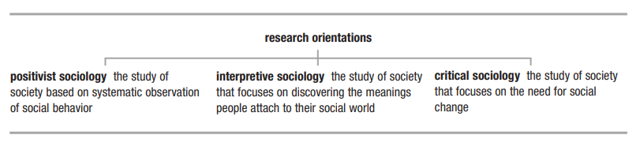
Research Orientations in Sociology

Slide 14
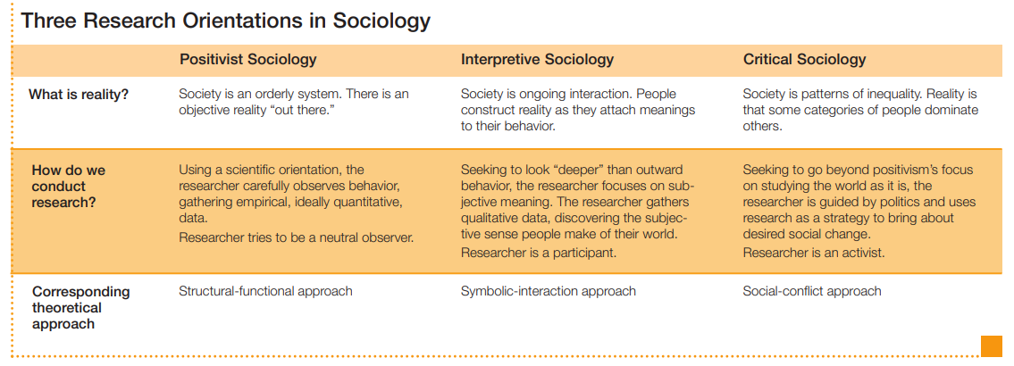

Slide 15
Important Concepts in Social Research (3/3)
Weber’s Concept of Verstehen Max Weber believed the key to interpretive sociology lay in Verstehen (pronounced “fair-SHTAY-in”), the German word for “understanding.” The interpretive sociologist does not just observe what people do but also understand as to why they do any act.
A research method is a systematic plan for doing research. Four commonly used methods of sociological investigation are experiments, surveys, participant observation, and the use of existing data
The experiment is a research method for investigating cause and effect under highly controlled conditions.
Hawthorne effect to refer to a change in a subject’s behavior caused simply by the awareness of being studied
Population, the people who are the focus of research.
A sample, a part of a population that represents the whole

Slide 16
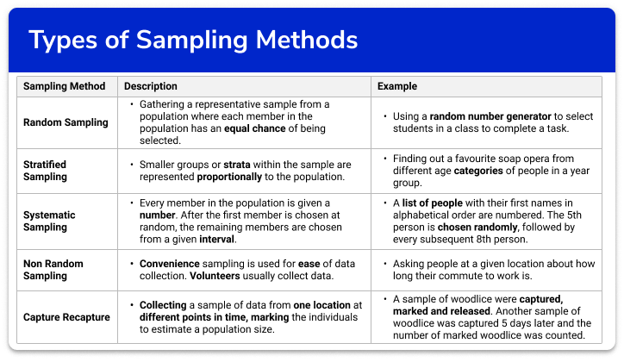

Slide 17
Four Research Methods
Survey is a research method in which subjects respond to a series of statements or questions on a questionnaire or in an interview.
A questionnaire is a series of written questions a researcher presents to subjects
An interview is a series of questions a researcher asks respondents in person
Participant observation, a research method in which investigators systematically observe people while joining them in their routine activities.

Slide 18
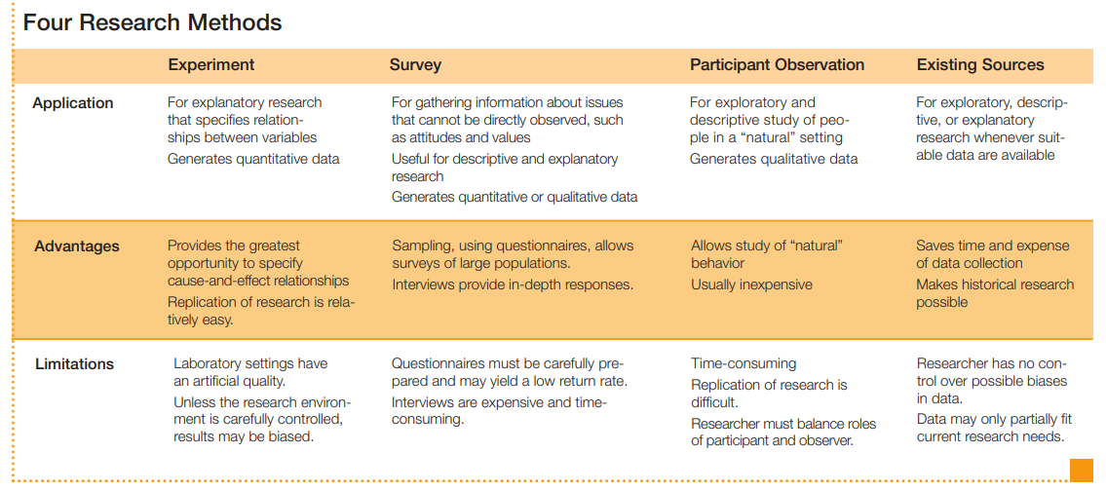

Slide 19
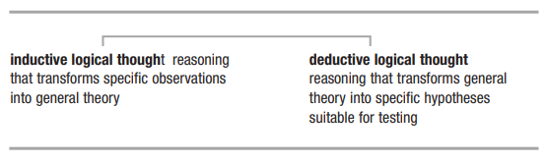
Inductive and Deductive Approach

Slide 20
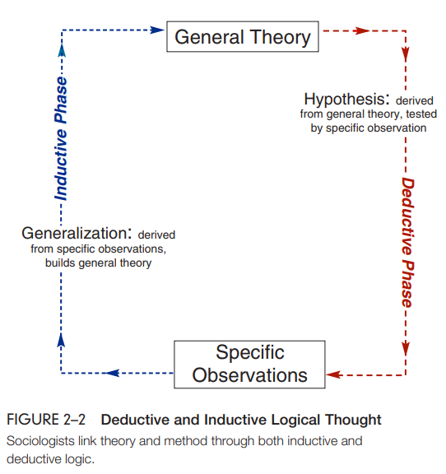
Inductive and Deductive Approach
Inductive logical thought is reasoning that transforms specific observations into general theory. In this mode, a researcher’s thinking runs from the specific to the general
Deductive logical thought is reasoning that transforms general theory into specific hypotheses suitable for testing. The researcher’s thinking runs from the general to the specific

Slide 21
Q&A Session

